Slide 1
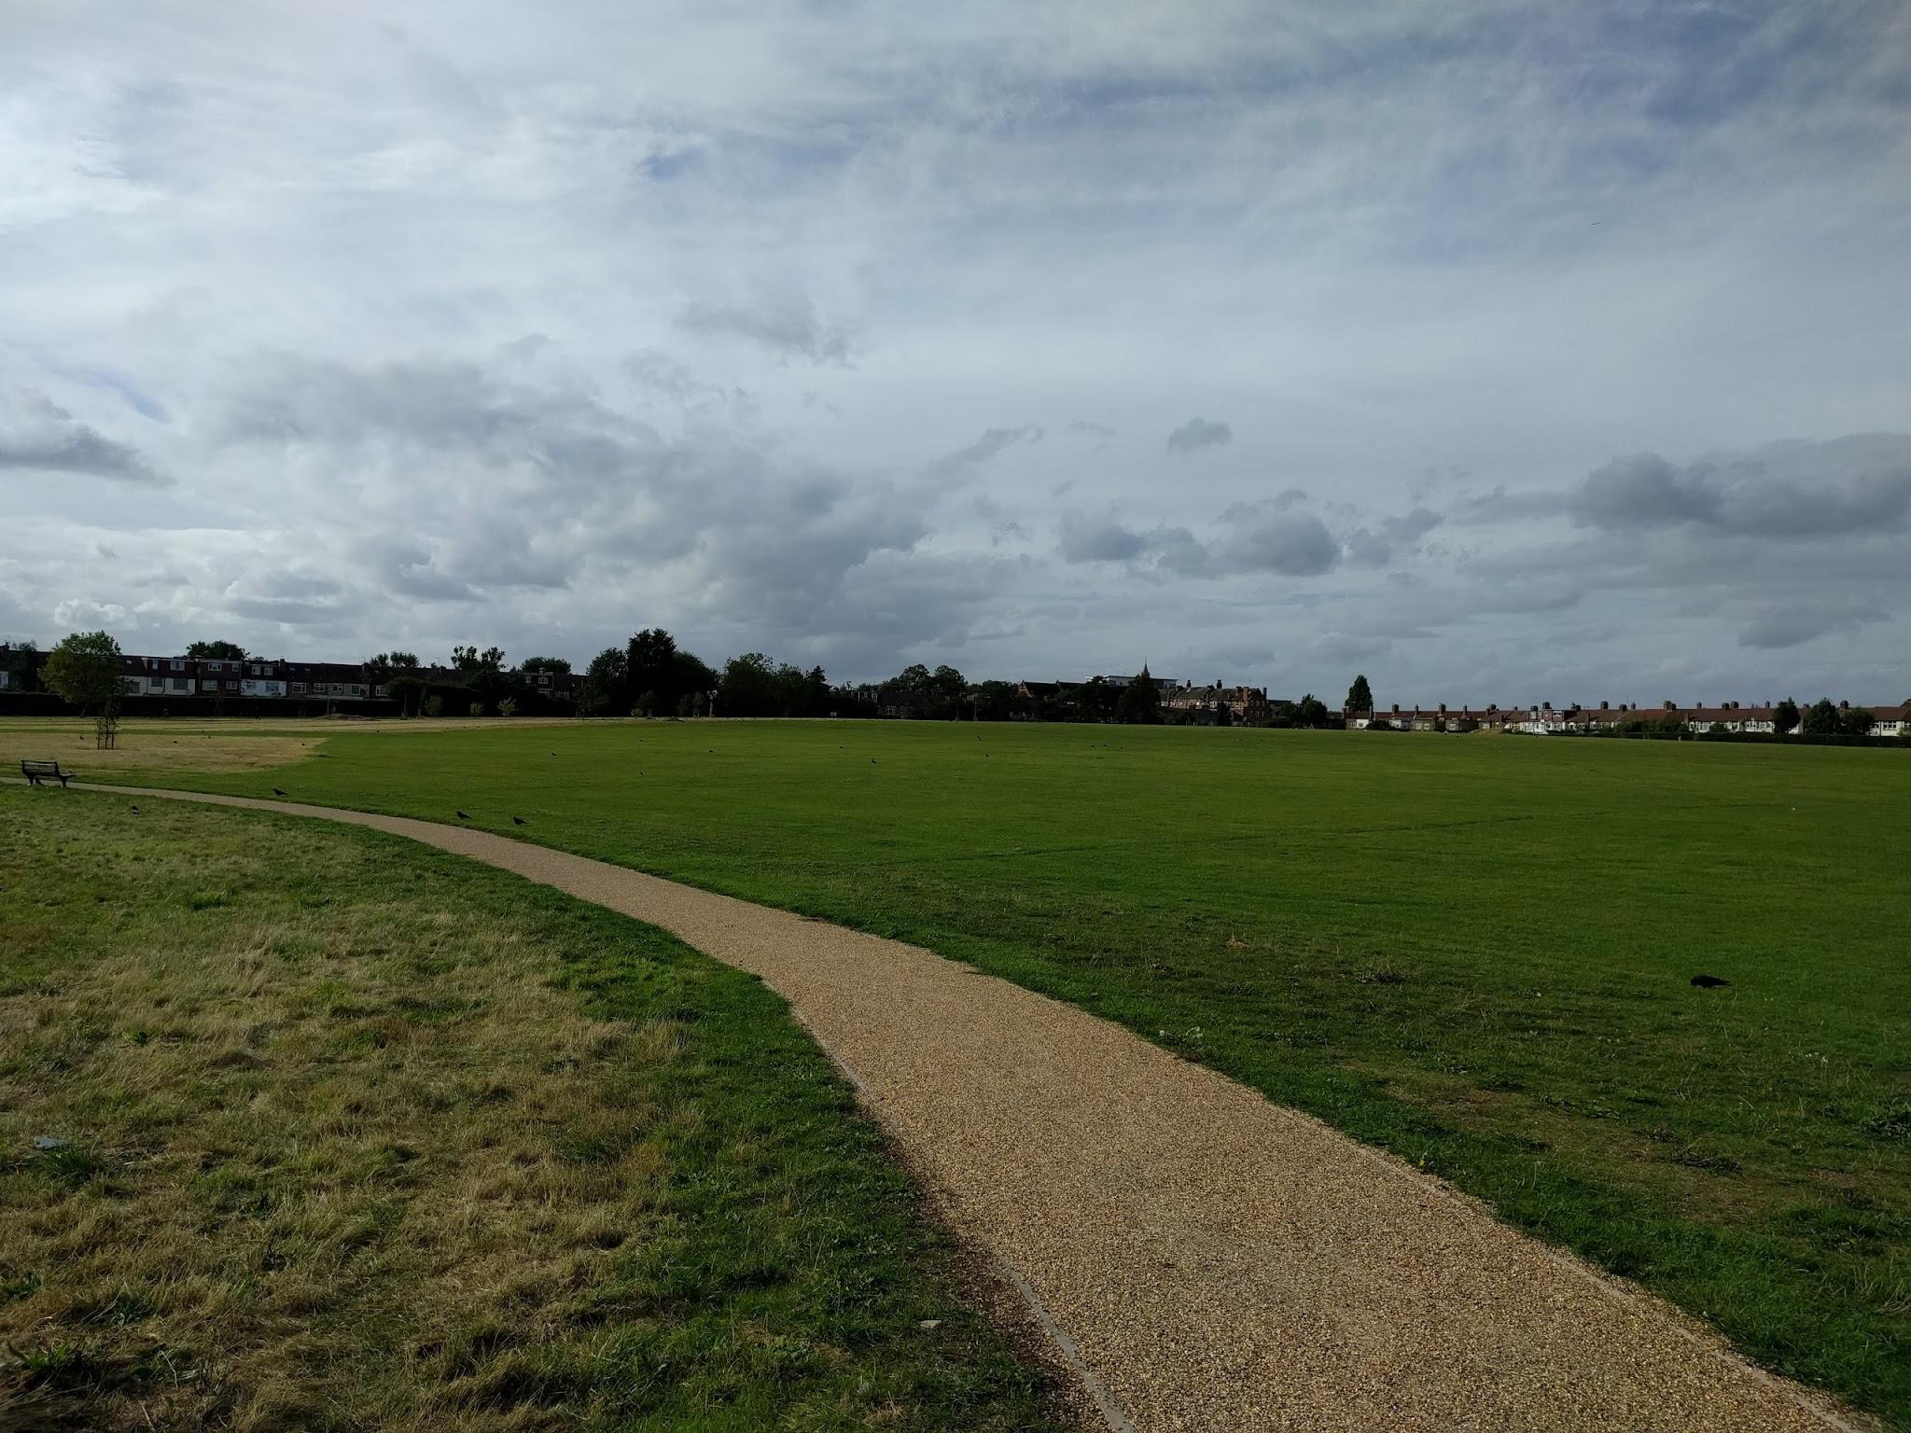
Once upon a Lark..
Or:
My journey into the world of open-source parsers

Slide 2
Backstory and motivation
First attempt - Plyplus
Writing Lark
Results

Slide 3
Backstory
Parsing, what is it good for?
(absolutely something!)
Parsers are EVERYWHERE:
Compilers - C, C++, C#, Java, SQL
Interpreters - Python, Php, Javascript, Bash
Configuration - Json, Ini, XML, Yaml
Browsers (html, css), Code editors
Natural Language Processing (NLP)

Slide 4
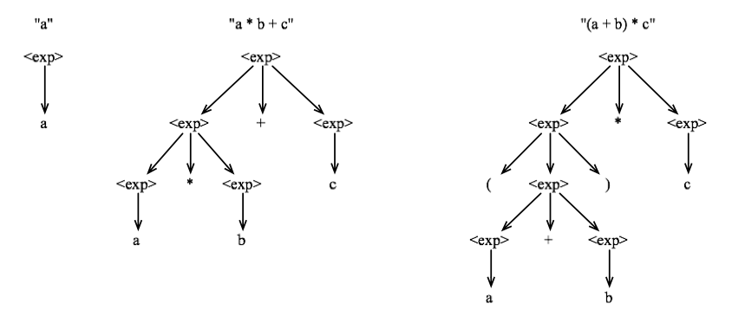
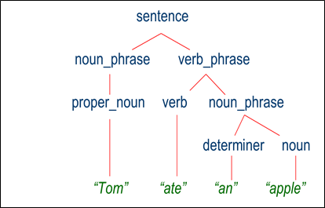
Parsing - Visual examples

Slide 5
What is parsing?
Parsing is the recognition of structure in a sequence of symbols
Humans do it all the time, but for computers it's not that simple.
Trivial solutions are VERY SLOW (Factorial run-time complexity)
An efficient catch-all solution is impossible (e.g. natural language)
Algorithms were developed for subsets of grammars, trying to offer a practical balance of performance and expressiveness
The most common subclass of grammars is the Context-Free Grammar (CFG), introduced by Noam Chomsky in 1957
Even CFGs are very difficult to parse, and most algorithms work for subsets of CFG grammars

Slide 6
LALR(1)
Look-ahead LR parser, works for a small subset of the CFG
Invented in 1969 by Frank DeRemer, based on the work of Donald Knuth (1965)
Can parse any compatible input in O(n) run-time, with very low memory requirements
Languages that can be parsed by LALR(1):
C (but not C++)
JSON, CSS
Python (with indentation pre-processing)
Java (with a few tricks)
About 90% of computer languages are LALR(1) compatible by design
Most popular LALR(1) parser is YACC (+ Lex), written in In the early 1970s, Stephen C. Johnson
In 2008, he said: "the contribution Yacc made to the spread of Unix and C is what I'm proudest of"
Adapted by David Beazley into Python in 2001, as a popular package called PLY (Python Lex Yacc)

Slide 7
YACC calculator
%token NAME %token NUMBER %token EQ %token PLUS MINUS TIMES DIV %left MINUS PLUS %left TIMES DIV %nonassoc UMINUS %% statement_list : statement | statement statement_list statement : NAME EQ expression ';' {vbltable[$1] = $3; } expression : expression PLUS expression {$$ = $1 + $3;} | expression MINUS expression {$$ = $1 - $3;} | expression TIMES expression {$$ = $1 * $3;} | expression DIV expression {$$ = $1 / $3;} | MINUS expression %prec UMINUS {$$ = - $2;} | '(' expression ')' { $$ = $2; } | NUMBER | NAME { $$ = vbltable[$1]; } %% main() { yyparse(); }
???
%{ #include "y.tab.h" extern int yylval; %} digit [0-9] letter [a-z] %% "+" {return PLUS;} "=" {return EQ;} "-" {return MINUS;} "*" {return TIMES;} "/" {return DIV;} {digit}+ {yylval = atoi(yytext); return NUMBER; } {letter} {yylval = yytext[0] - 'a'; return NAME;} [ \t]+ ; \n ; . {return yytext[0];} %%

Slide 8
PLY Calculator
tokens = 'NAME', 'NUMBER'
literals = ['=', '+', '-', '*', '/', '(', ')']
t_NAME = r'[a-zA-Z_][a-zA-Z0-9_]*'
def t_NUMBER(t):
r'\d+'
t.value = int(t.value)
return t
t_ignore = " \t"
def t_newline(t):
r'\n+'
t.lexer.lineno += t.value.count("\n")
def t_error(t):
print("Illegal character '%s'" % t.value[0])
t.lexer.skip(1)
# Build the lexer
import ply.lex as lex
lex.lex()
precedence = (
('left', '+', '-'),
('left', '*', '/'),
('right', 'UMINUS'),
)
names = {}
def p_error(p):
if p:
print("Syntax error at '%s'" % p.value)
else:
print("Syntax error at EOF")
def p_statement_assign(p):
'statement : NAME "=" expression'
names[p[1]] = p[3]
def p_statement_expr(p):
'statement : expression'
print(p[1])
def p_expression_binop(p):
'''expression : expression '+' expression
| expression '-' expression
| expression '*' expression
| expression '/' expression'''
if p[2] == '+':
p[0] = p[1] + p[3]
elif p[2] == '-':
p[0] = p[1] - p[3]
elif p[2] == '*':
p[0] = p[1] * p[3]
elif p[2] == '/':
p[0] = p[1] / p[3]
def p_expression_uminus(p):
"expression : '-' expression %prec UMINUS"
p[0] = -p[2]
def p_expression_group(p):
"expression : '(' expression ')'"
p[0] = p[2]
def p_expression_number(p):
"expression : NUMBER"
p[0] = p[1]
def p_expression_name(p):
"expression : NAME"
try:
p[0] = names[p[1]]
except LookupError:
print("Undefined name '%s'" % p[1])
p[0] = 0
????

Slide 9
Better Calculator
?start: sum
| NAME "=" sum -> assign_var
?sum: product
| sum "+" product -> add
| sum "-" product -> sub
?product: atom
| product "*" atom -> mul
| product "/" atom -> div
?atom: NUMBER -> number
| "-" atom -> neg
| NAME -> var
| "(" sum ")"
%import common.CNAME -> NAME
%import common.NUMBER
%ignore " "
@v_args(inline=True) # Affects the signatures of the methods
class CalculateTree(Transformer):
from operator import add, sub, mul, truediv as div, neg
number = float
def __init__(self):
self.vars = {}
def assign_var(self, name, value):
self.vars[name] = value
return value
def var(self, name):
return self.vars[name]

Slide 10
Backstory and motivation
First attempt - Plyplus
Writing Lark
Results

Slide 11
PlyPlus
“Plyplus is a general-purpose parser built on top of PLY”
Main Concepts
Separation of code from grammar - Cleaner; more readable; portable
Always build an Abstract Syntax Tree (AST) - much simpler than working with a state-machine.
Beginner friendly
Features
Expressive grammar
Parentheses, repetition, inline tokens, and more
Selectors: queries on the AST
Nested grammars
Friendly documentation.

Slide 12
PlyPlus vs PLY
PlyPlus:
func_call: func_name “(“ [arg (“,” arg)*] “)”
Translated to PLY (in practice even uglier):
func_call: func_name LPAR args RPAR
| func_name LPAR RPAR
args: arg
| args COMMA arg
COMMA: “,”
LPAR: “(“
RPAR: “)”

Slide 13
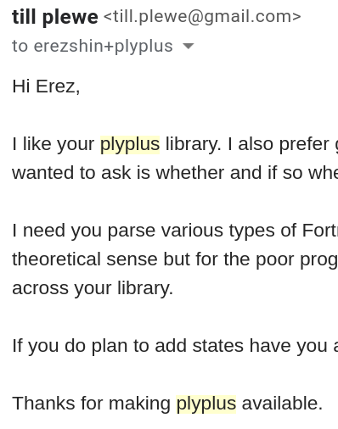
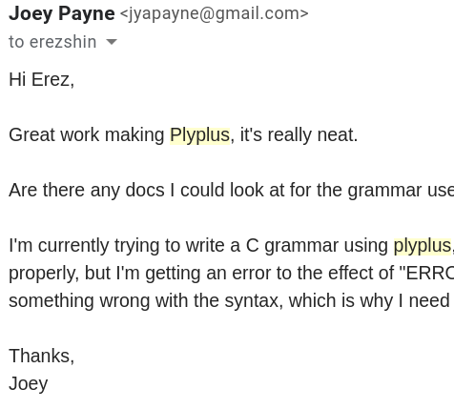
PlyPlus - Reactions

Slide 14
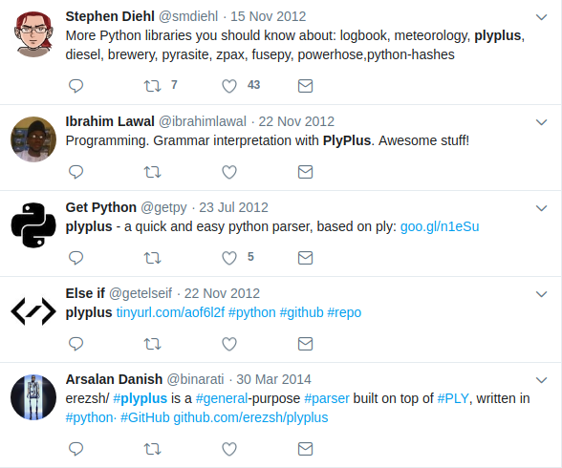
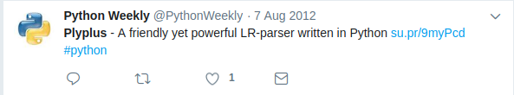
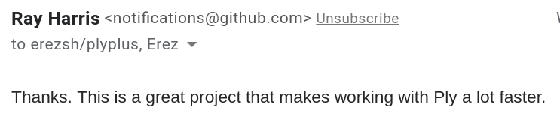
PlyPlus - More reactions

Slide 15
PlyPlus - Summary
268 commits, 2k lines of core functionality (excluding tests and examples)
10 other coders contributed features and bugfixes
Many hours of work
My takeaway:
I had fun writing it, and helped others on the way
I used it myself in many future projects
It proved that programmers care a lot about the interface of their libraries
But, it wasn’t a good enough parser, mostly because it relied on PLY
Impossible to make a standalone parser
PLY is limited to LALR, has quirks, and hard to extend

Slide 16
Backstory and motivation
First attempt - Plyplus
Writing Lark
Results

Slide 17

Fast-forward to 2017
PLY was still dominant :/
Beazley created SLY
“SLY originates from the PLY project. However, it's been modernized a bit”
Other parsers on the scene are all PEG: PyParsing, Parsimonious
PEGs are slow and memory-consuming
Introduced by Bryan Ford in 2004
More expressive than LALR(1), but still a limited subset of CFGs
Lack rigorous mathematical research
My interest in parsing grows (partly out of necessity), and I learn about the Earley algorithm

Slide 18
Quick Interlude - the Earley algorithm
Invented by Jay Earley in 1968
Can parse any context-free grammar in O(n^3)
Yes, including ambiguous grammars
But, it’s based on a chart-parser (i.e. interpreter parsing), so its constant time performance is atrocious. For 1968, at least.
Gained some popularity over the years for its usefulness in NLP
Received updates and corrections, approx. 1 per decade
Also, it’s hard to implement
And very hard to implement correctly

Slide 19
LALR(1) | O(n) | Very limited subset of CFGs
Earley | O(n^3) | All CFGs
Together, they provide both extremes of context-free parsing, and a good coverage of use-cases
Earley can parse LALR(1) grammars (of course)
This realization led me to the idea of a dual-parser
Allows the user to write any grammar they want, and later optimize it if they need the speed
Or, start with a fast, restricted grammar, and open it up if they need more power

Slide 20
I implemented my own version of LALR(1) parser. It took only 300 lines, compared to PLY’s 3000.
Yet, it was just as fast and capable
I implemented the Earley algorithm, adapted from a Javascript library called Nearley.
I added an interface similar to PlyPlus, but with all the lessons that I learned over the years
I also added a few improvements to the parsing algorithms, mostly in their communication with the lexer:
Added a “Contextual Lexer” feature, which creates and manages lexer states automatically, allowing Lark’s LALR(1) to parse things that YACC and PLY cannot.
Added a “Dynamic Lexer” to the Earley algorithm, which allows it to use regular expressions for improved performance, without losing any of its parsing power.

Slide 21
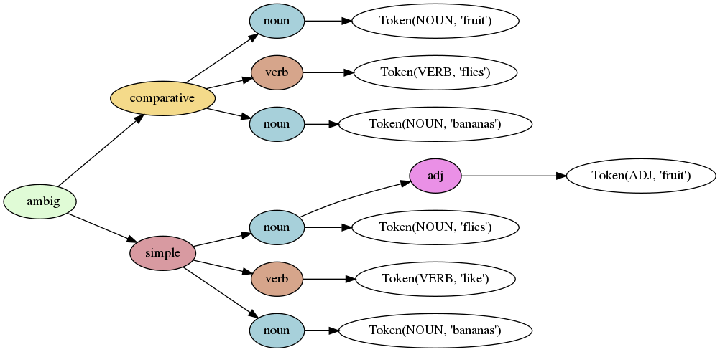
Fruit Flies Like Bananas

Slide 22
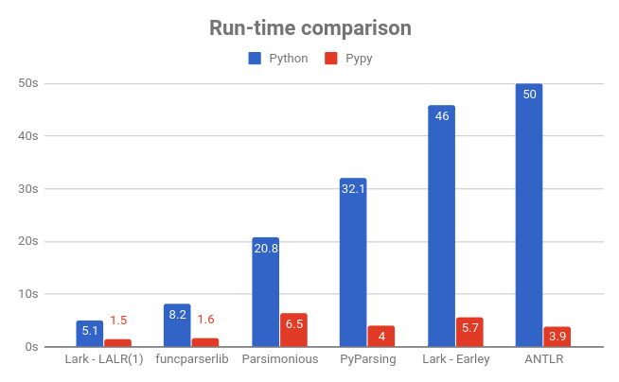

Slide 23
Backstory and motivation
First attempt - Plyplus
Writing Lark
Results

Slide 24
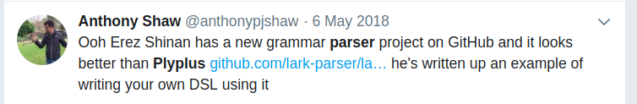
Advertised on reddit & hackernews, wrote a couple of blog posts
Started getting serious contributions
CYK parser from a Google employee
Syntax highlighting for vscode and sublime
Improvements to the Earley parser
Receive an endless torrent of bugfixes, issues, questions, etc.

Slide 25


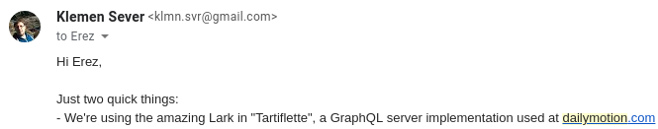
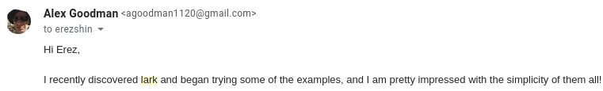
Lark - Reactions
IBM
Nearley
Dailymotion
NASA

Slide 26
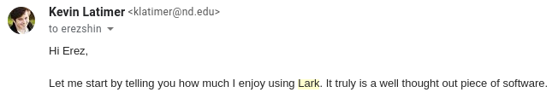
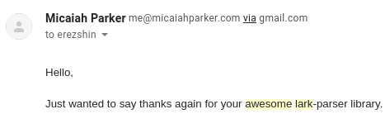
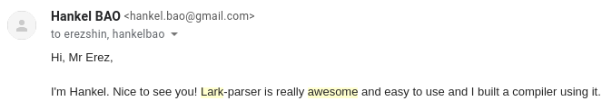
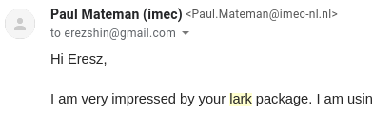
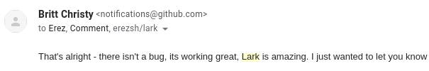
Lark - Reactions

Slide 27
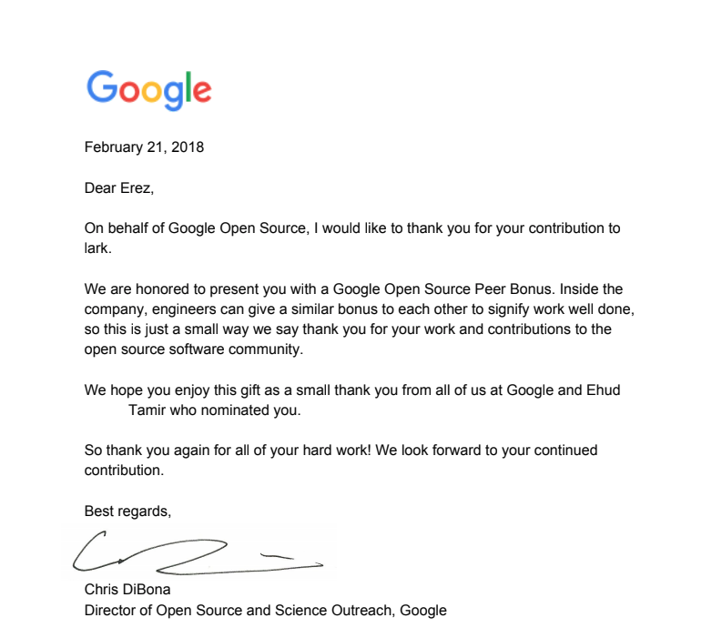

Slide 28
Was it all worth it?
CONS
Dozens of hours of unpaid work
Some of it was hard and boring (tests & docs)
PROS
Fun to write
Learned in the process
It’s fulfilling to help, and be useful
Source of pride
Sense of accomplishment
Recognition
Supplements my resume (very effective!)
Received several job offers
More to come?

